Slide 1
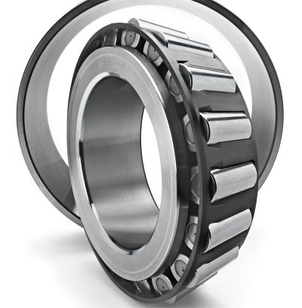
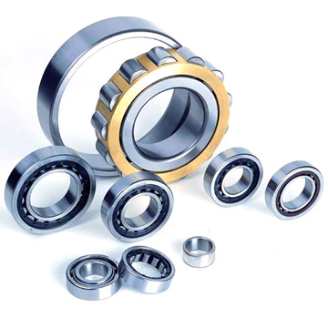
MECH 325 Rolling Element Bearings - Part 1

Slide 2
Objectives
By the end of this section, you should be able to:
  Identify types, uses, and characteristics of rolling element bearings
  Determine bearing life (under steady radial and thrust loads) for a given application based on manufacturer data
  Select a rolling element bearing for a given application
MECH 325

Slide 3
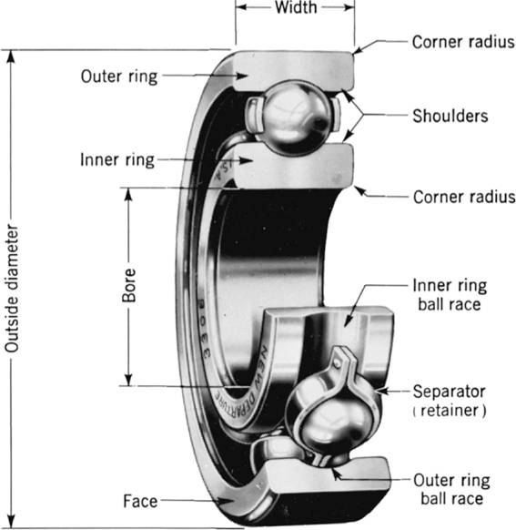
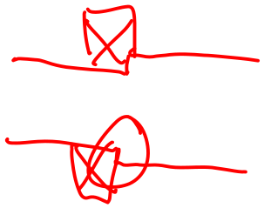
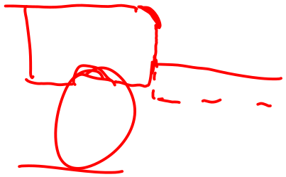
Bearing Nomenclature
MECH 325

Slide 4
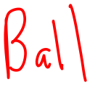
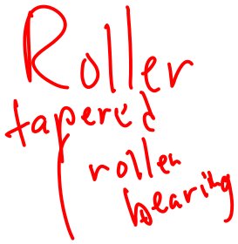


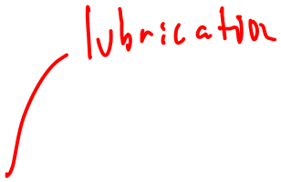
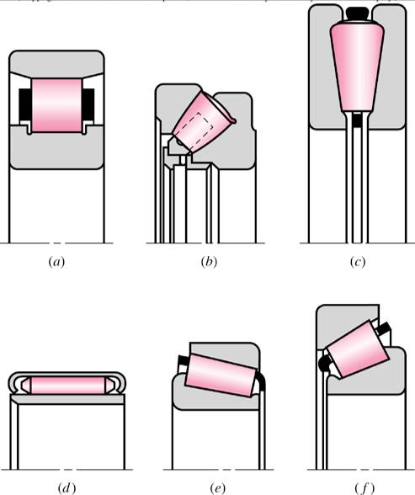
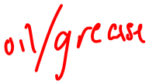
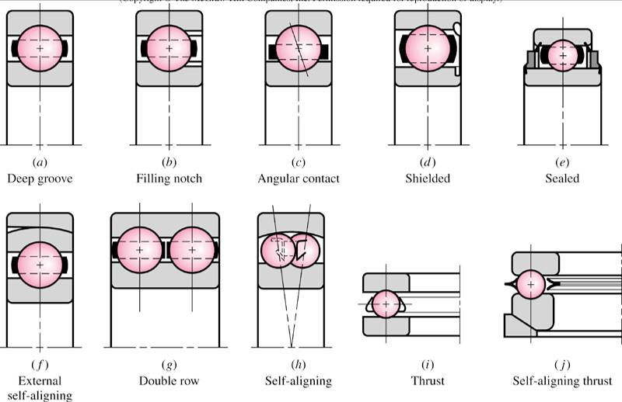


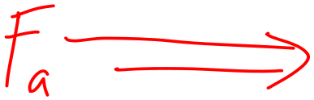








Rolling Element Bearing Types
MECH 325

Slide 5
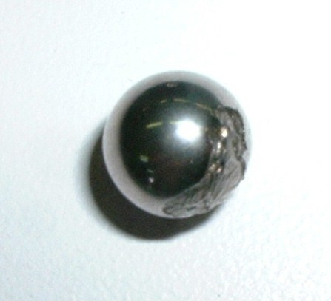
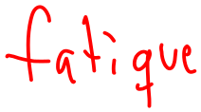















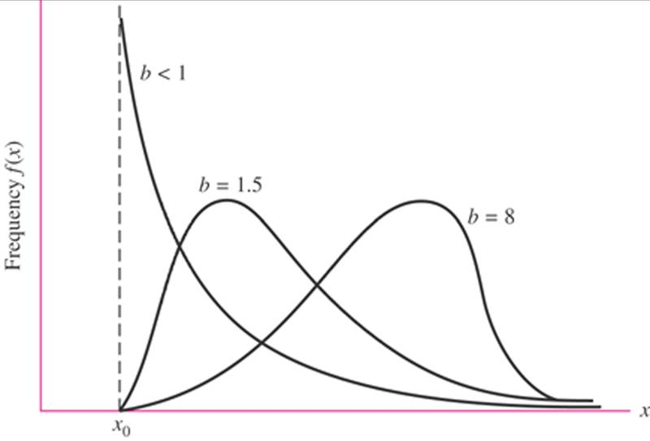
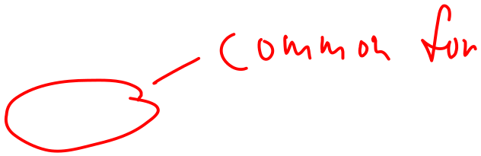

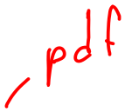


Bearing Failure
Common measure of bearing failure:
Statistical in nature; described by Weibull distribution:
  x = life
  x₀ = guaranteed life
  b = shape parameter
  θ = scale parameter
MECH 325

Slide 6
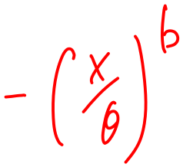

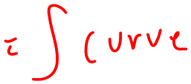


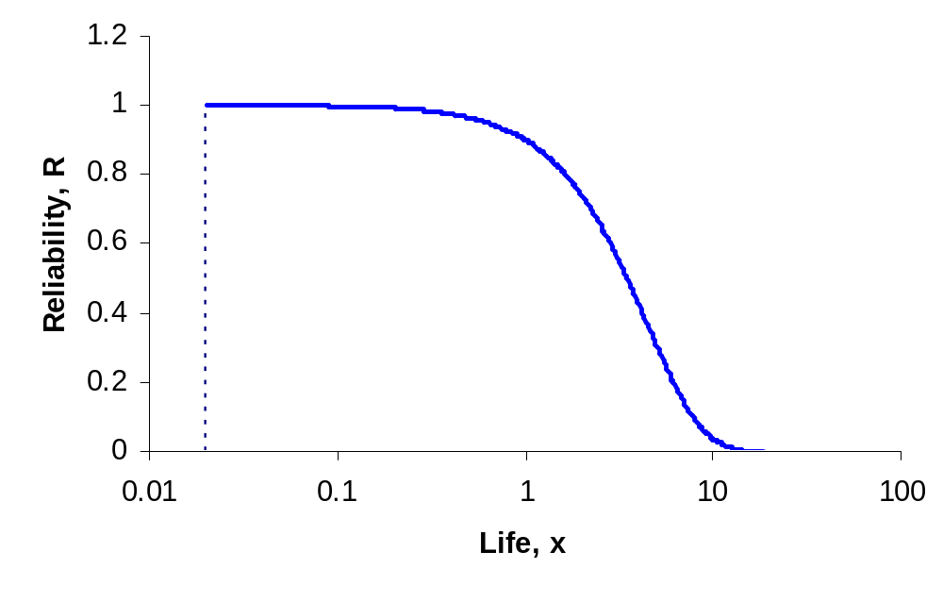
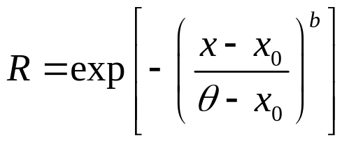






















Bearing Reliability
R = reliability
x₀ b and θ provided by manufacturer (e.g. x₀ = 0.02, b = 1.483 and, θ = 4.459)
MECH 325

Slide 7















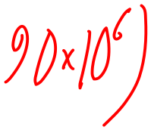







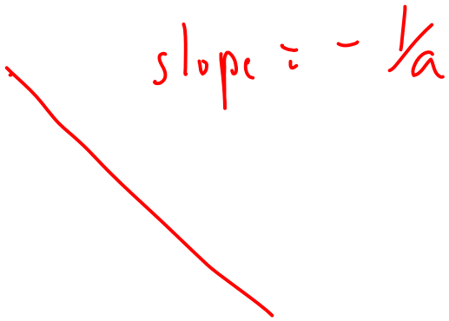
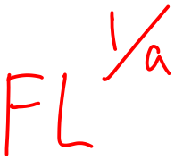
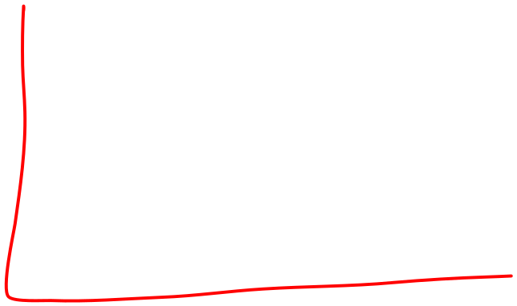
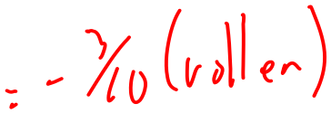


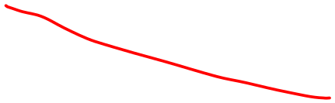
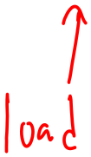
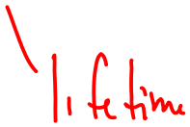
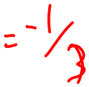




Rolling Element Bearings: Life
Rating life (L₁₀ life)
  Meaning:
  Values:
Life versus radial load
MECH 325

Slide 8
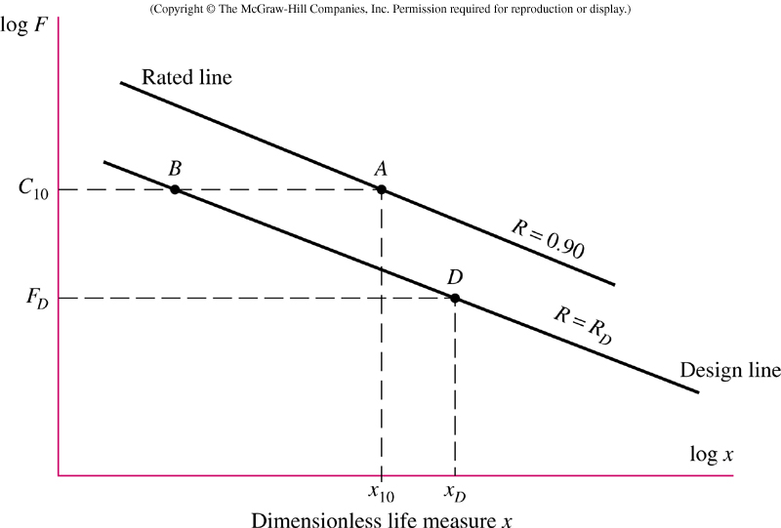





Reliability Contours
Manufacturer provides enough information to define the curves
Designer moves between curves
x = L/L₁₀
MECH 325

Slide 9
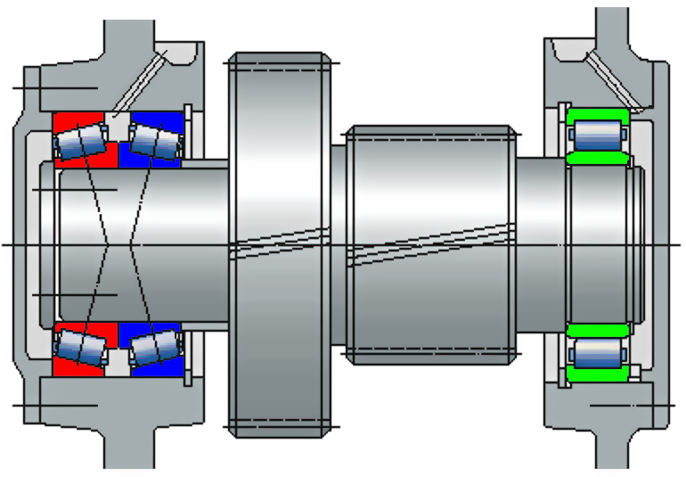










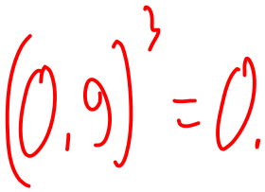
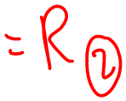

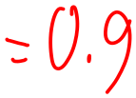

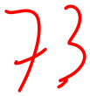


System Reliability
An assembly uses three bearings
  ①② identical tapered roller
  ③ cylindrical roller
What is the system reliability if:
  R① = 0.9, R② = 0.8, and R③ = 0.7
  x = 1 and F = C₁₀ for all 3 bearings
①
③
②
MECH 325

Slide 10



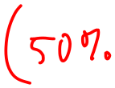


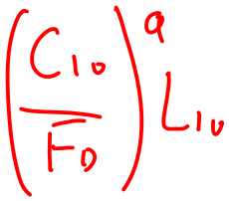
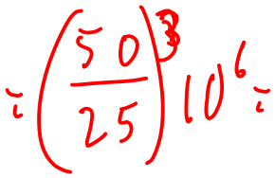


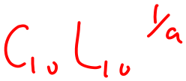




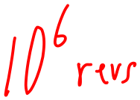
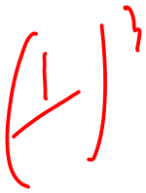










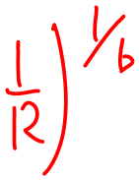
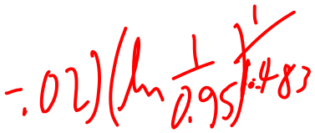

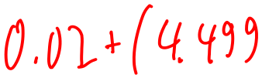
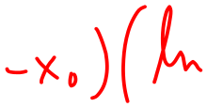










Questions on Reliability and Life
A ball bearing has a catalog load rating of 50 kN and rating life of 10⁶ revs (x₀ = 0.02, b = 1.483 and, θ = 4.459).
  How long will the bearing last (with 0.90 reliability) if the load is 25 kN?
  How long will the bearing last if the load is doubled (0.90 reliability)?
  How long will the bearing last if the reliability is 0.95?
MECH 325

Slide 11
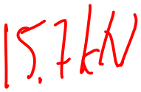











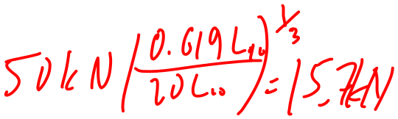


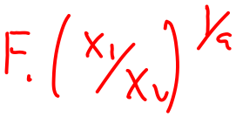


Questions on Reliability and Life
A ball bearing has a catalog load rating of 50 kN and rating life of 10⁶ revs (x₀ = 0.02, b = 1.483 and, θ = 4.459).
  What is the maximum load for which the bearing will reach 20x10⁶ revolutions (0.95 reliability)?
A ball bearing and a roller bearing have the same values of C₁₀ and L₁₀. Which has longer life if F < C₁₀ (or are they the same)?
MECH 325

Slide 12




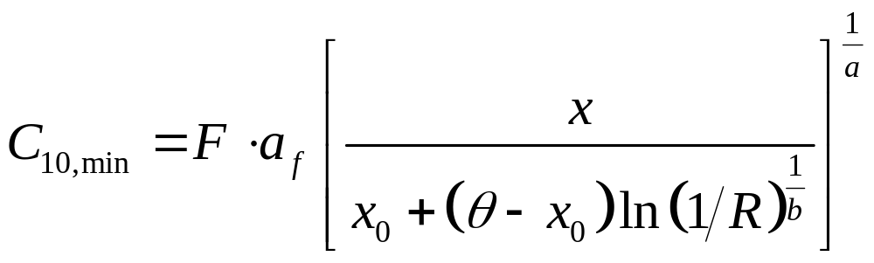
Bearing Selection: Radial Load
For slow rotation (≤ 5 rpm) use the static load rating, C₀
  F_{r} ∙ n_{sf} ≤ C₀
For normal rotation (>5 rpm) use the dynamic load rating, C₁₀
MECH 325

Slide 13





Application Factors
Application factor: a_{f}
Like a factor of safety; modify the equivalent load before selecting a bearing
MECH 325

Slide 14

MECH 325

Slide 15

MECH 325

Slide 16





Bearing Selection: Radial and Axial Load
Need to find equivalent radial load
  F_{e} = X_{i}VF_{r} + Y_{i}F_{a}
  V = 1 (inner race rotates)
  V = 1.2 (outer race rotates)
  Values of X_{i} and Y_{i} found in Table 11-1.
MECH 325

Slide 17




Equivalent Radial Load Factors
Table 11-1
MECH 325

Slide 18







































Combined Load Example
An 02-40mm angular-contact ball bearing has an axial load F_{a} of 2.05 kN and a radial load F_{r} of 3.12 kN. The inner race is stationary and the outer race turns at 500 rev/min. (Assume x₀ = 0.02, b = 1.483, θ = 4.459)
What equivalent radial load F_{e} should be used?
MECH 325

Slide 19







































Combined Load Example – con’t
If the rated life (for radial loads) is 10⁶ revolutions, how many revolutions would be expected with 0.95 reliability?
MECH 325

